Slide 1
McKenzie River Interpretive Center
The Dream:
A world class facility to showcase the McKenzie’s source, its fish and her people and their boats through interactive and transformation experiences.
Spawning Grounds

Slide 2
Conceived by the MRGA
Background – MRGA
December 2012 brainstorm session of 46 stakeholders & Interpretive Plan
Three task forces formed
Hydrology/Geology (Gordon and Kathy co-chairs)
Fish (Jeff and Andy co-chairs)
Boats and guides (Roger and Dave co-chairs)

Slide 3
Consultant, Jan Coleman Red Caviar Planning and Design, LLC, Portland
Author of the Interpretive Plan
Plan includes three Interpretive story zones:
The guides, their boats and their culture
The unique geology and hydrology that creates the McKenzie
The fish and their habitat

Slide 4
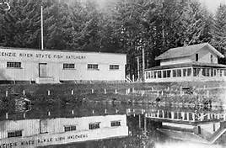
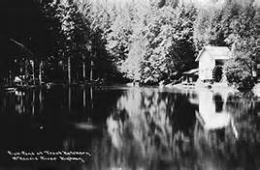
Where?
Old Leaburg Fish Hatchery

Slide 5
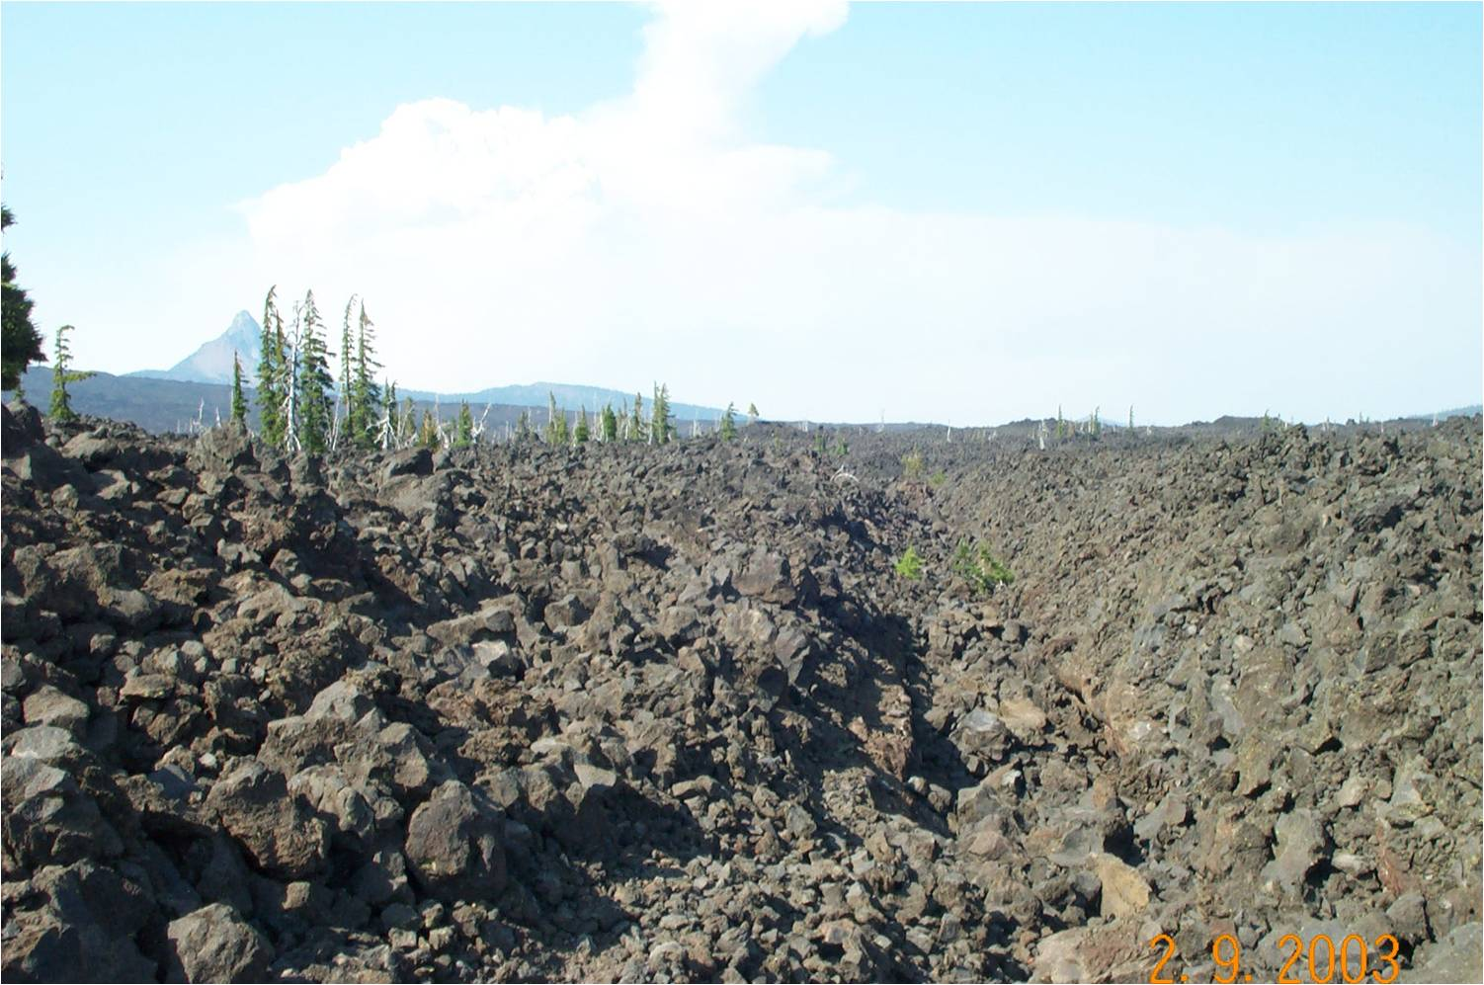
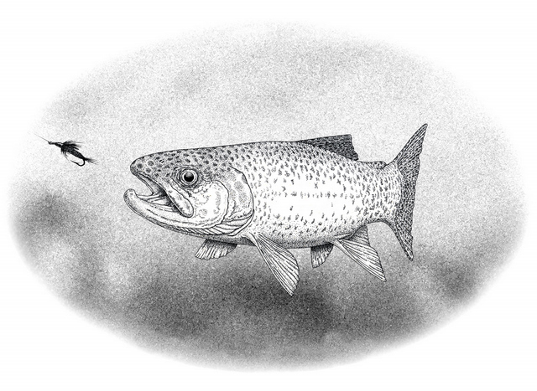
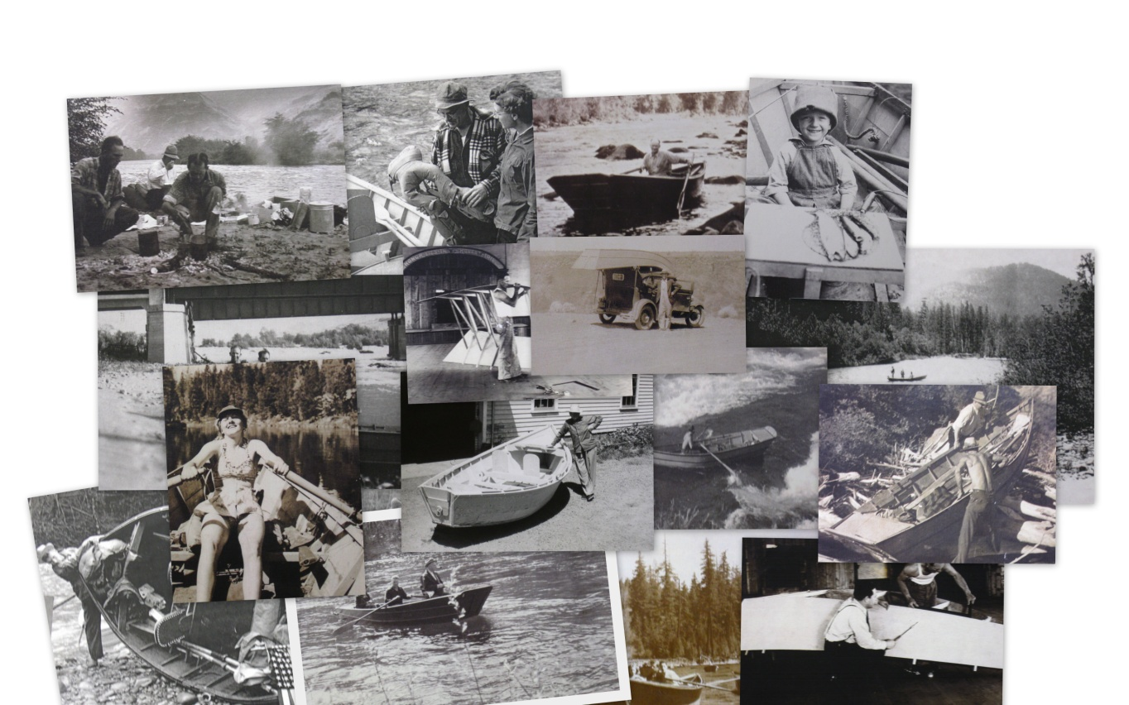
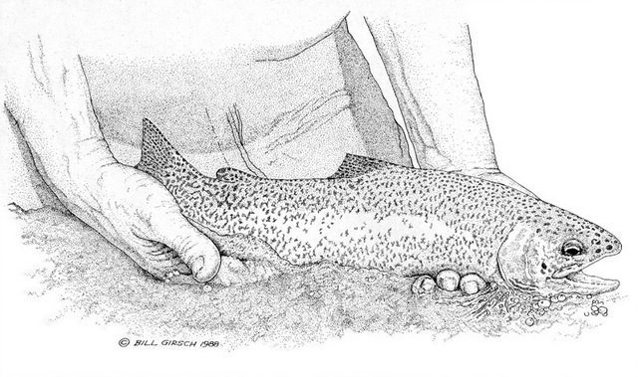
Its unique origins
What?
Her Fish
Her people and boats

Slide 6
Imagine: Tour of spawning grounds
Simulator
Lobby
Heritage walk
B
O
A
T
S
&
Parking
Simulator
Lobby
Theater
Theater
Artifacts
Open boat storage
Trail
Lab
G U I D E S

Slide 7
Pavilion Lobby
Life size scene foreground, including river frontage, and blended mural background.

Slide 8
Setting the Context

Slide 9
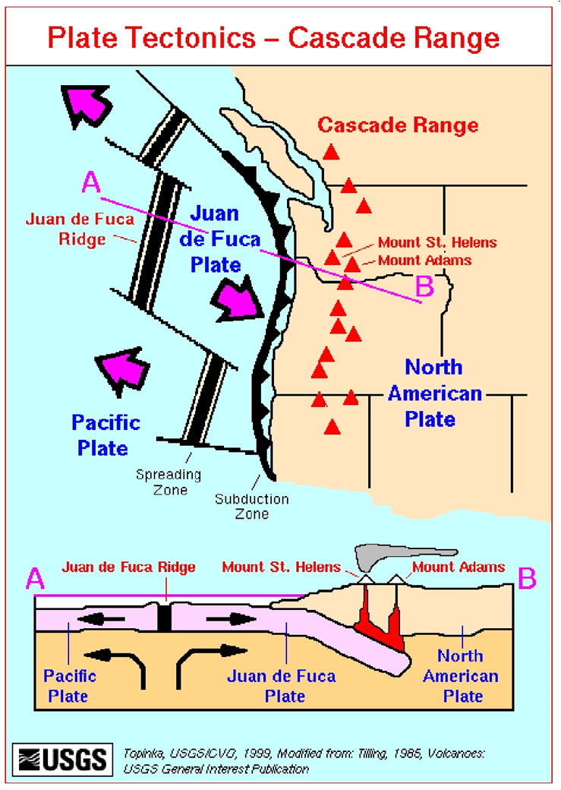
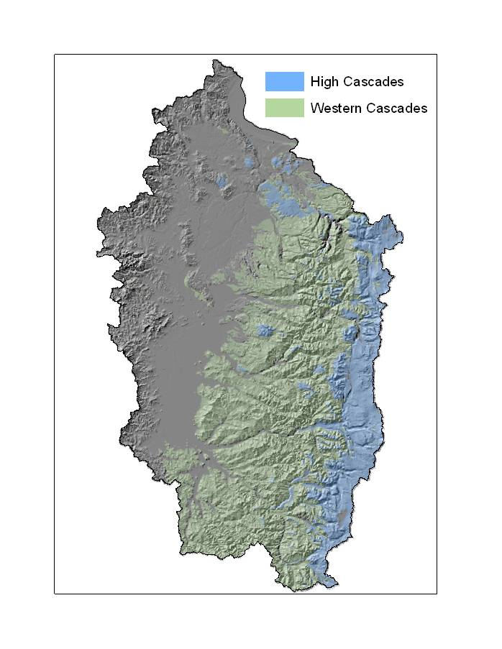
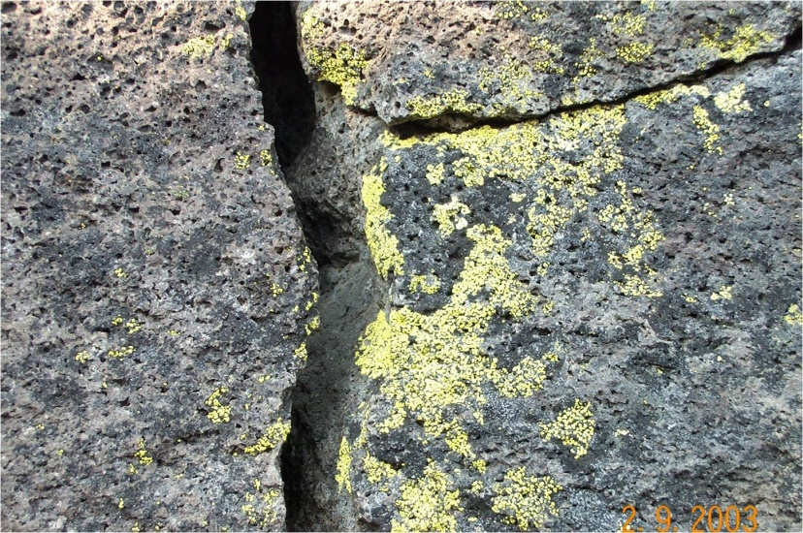
Theater Event = Spawning events
10 million years ago to present – groundwork and multi-media.

Slide 10
Exit Theater through the Groundwork
To the McKenzie Trail

Slide 11
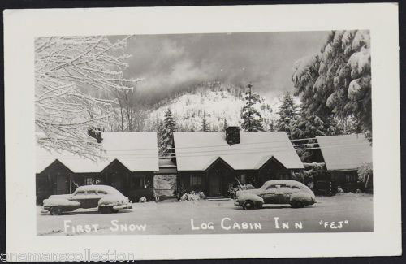
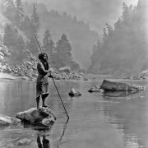
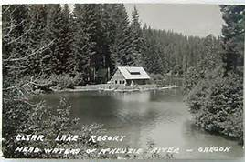
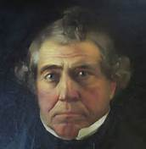
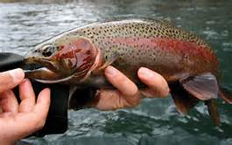
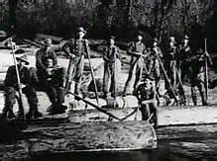
The McKenzie Trail

Slide 12
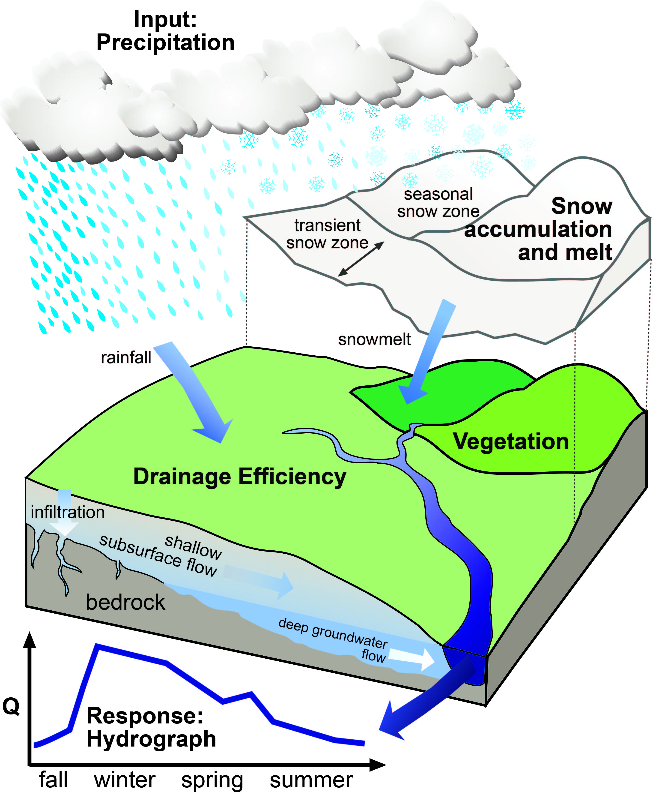
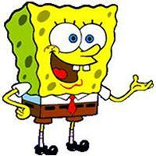
Tamolitch Lab – Table experiments
How do changes in climate affect the
McKenzie
Winter vs Summer flow
How much water is in the sponge?
Calculate age of water emerging from springs

Slide 13
Diagram
Tamolitch Lab to the Trailhead

Slide 14
The Old McKenzie Fish Hatchery

Slide 15
The Old McKenzie Fish Hatchery
Fish ID and River Ecology Pavilion

Slide 16
Fish ID and River Ecology Pavilion
Includes a movie of water working down the river (Hydrology to Fish segue)
Identification and life histories of McKenzie river fishes

Slide 17
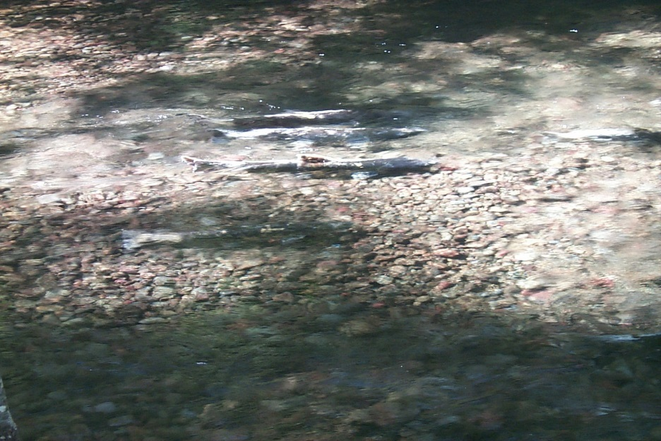
Chinook Salmon Oncorhynchus tshawytscha

Slide 18
Rainbow Trout Oncorhynchus mykiss
A. Thomason

Slide 19
Cutthroat Trout Oncorhynchus clarki

Slide 20
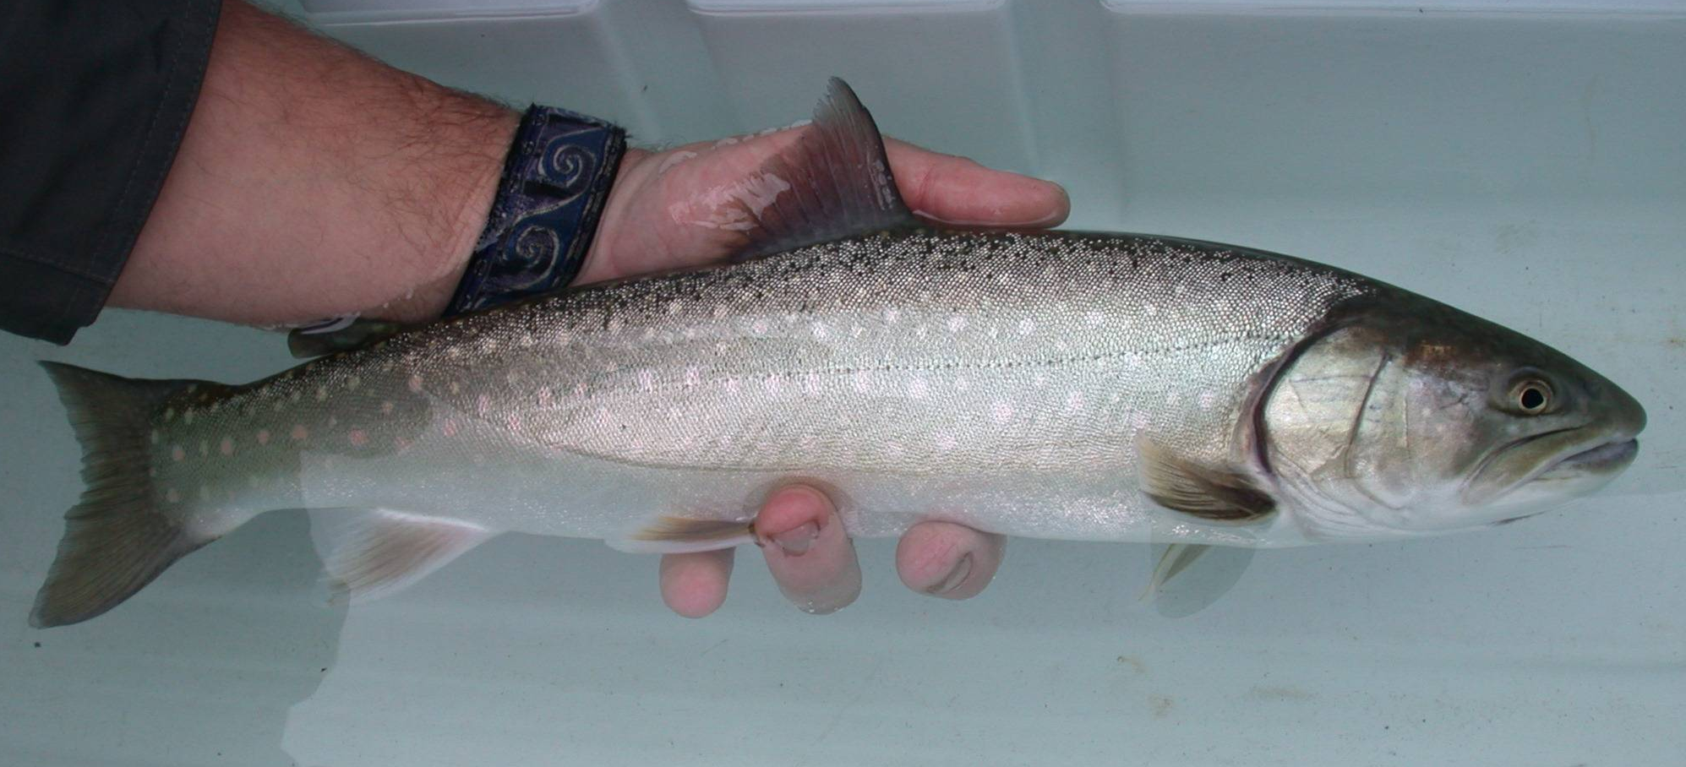
Bull Trout Salvelinus confluentus

Slide 21
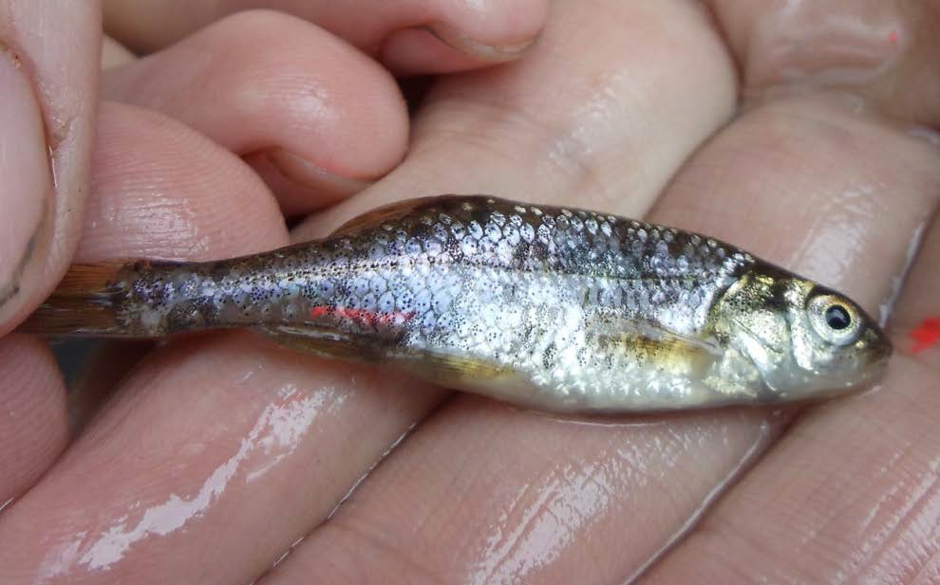
Oregon chub Oregonichthys crameri

Slide 22
Pacific lamprey Lampetra tridentata

Slide 23
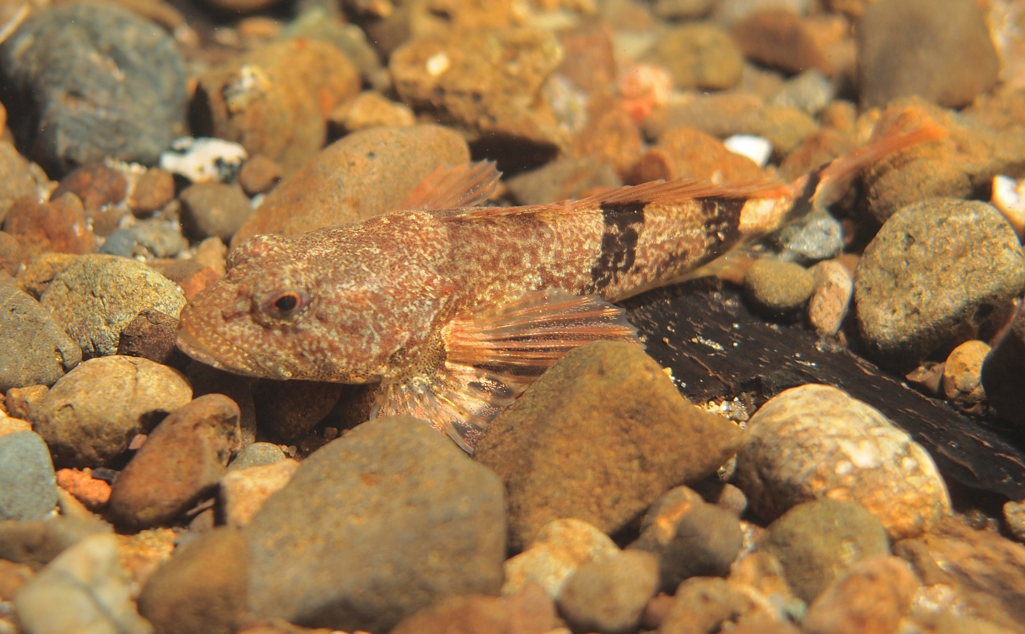
Torrent Sculpin Cottus rhotheus
Roger Tabor (USFWS)

Slide 24
Fish ID and River Ecology Pavilion
Includes a movie of water working down the river (Hydrology to Fish segue)
ID and life histories of McKenzie river fishes
ID of area mammals, birds, herptiles and macroinvertebrates
Uniqueness of the McKenzie River ecological community
Why do we have resident rainbow and few steelhead?
Spring Chinook – cornerstone popn of the Willamette and ocean nutrient cycling vehicle

Slide 25
The Old McKenzie Fish Hatchery
Underwater viewing chamber
Casting Pond
Fish ID and River Ecology Pavillion

Slide 26
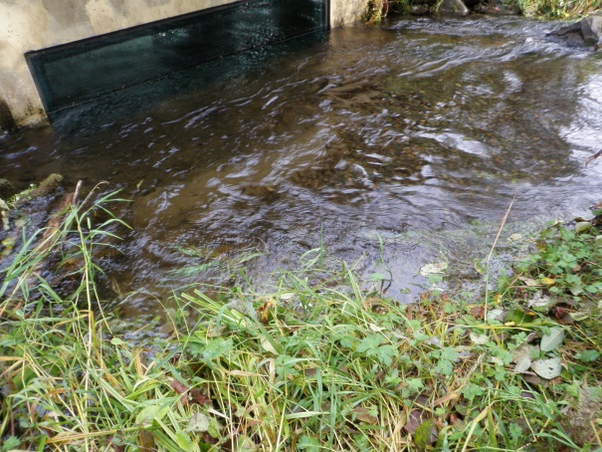
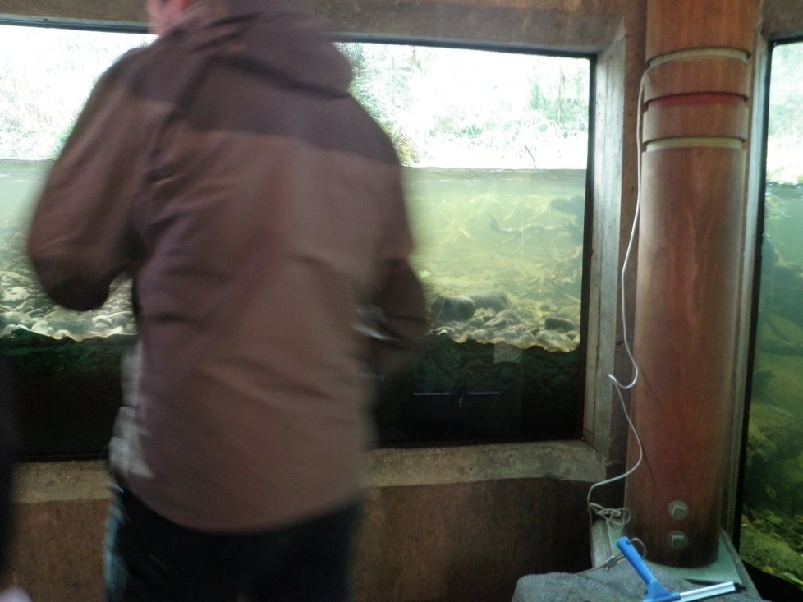
Underwater Viewing Chamber

Slide 27
The Old McKenzie Fish Hatchery
Underwater viewing chamber
Casting Pond
Fish ID and River Ecology Pavillion

Slide 28
The Old McKenzie Fish Hatchery
Underwater viewing chamber
Casting Pond
Fish ID and River Ecology Pavillion
Fish Hatcheries: Past, Present and Future

Slide 29
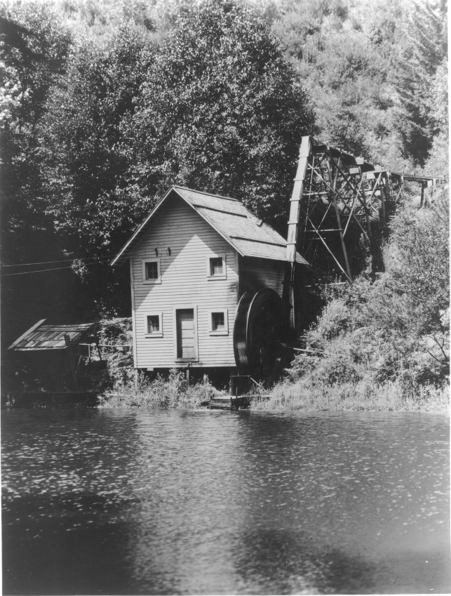
Fish Hatcheries: Past, Present and Future

Slide 30
The Old McKenzie Fish Hatchery
Underwater viewing chamber
Casting Pond
Fish ID and River Ecology Pavillion
Fish Hatcheries: Past, Present and Future
Working Satellite Research Hatchery for McKenzie/Leaburg Hatcheries

Slide 31
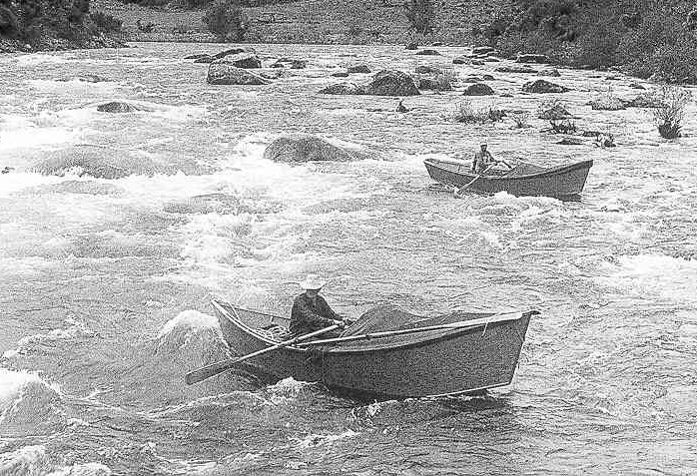
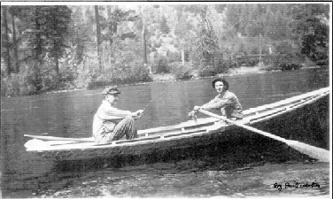
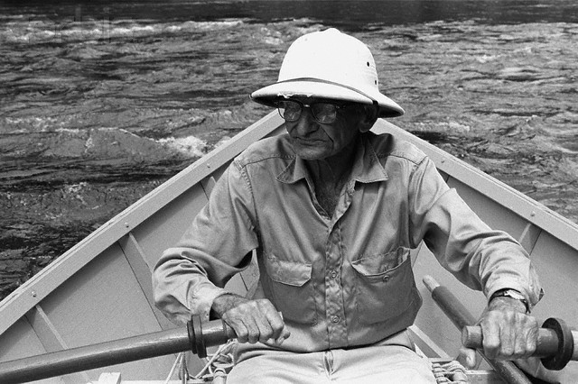
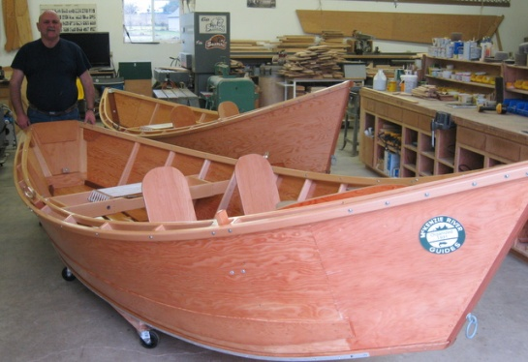
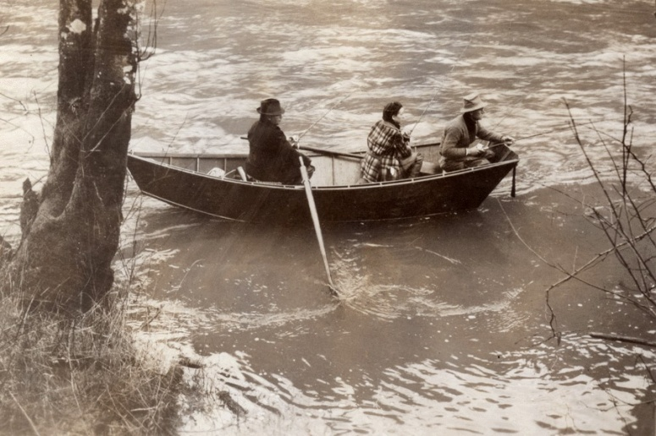
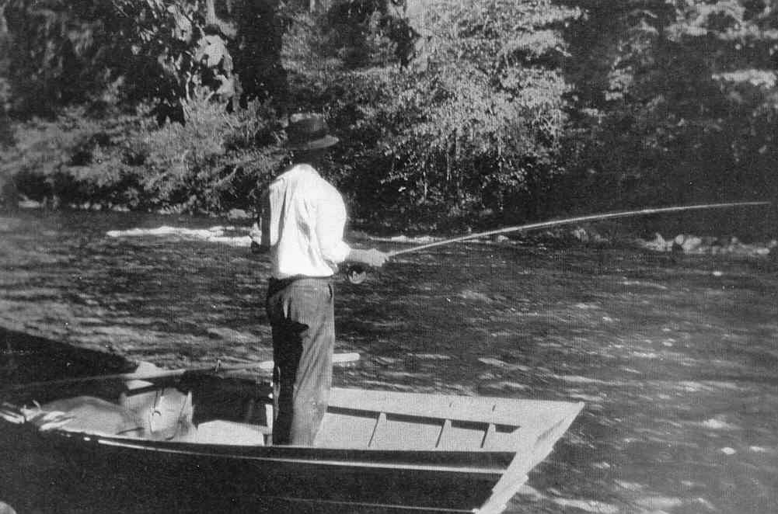
The Boats and Guides
6 or 7 life size exhibits

Slide 32
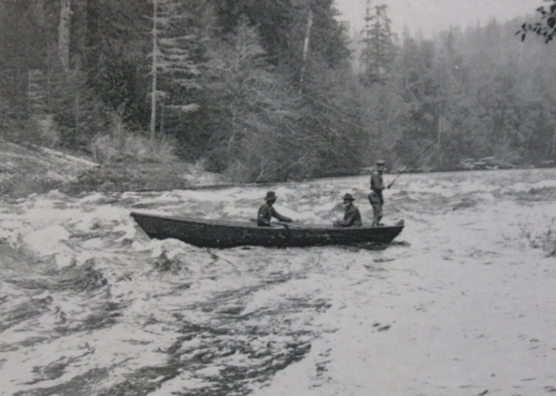
Simulations ideas
Simulated run through Martin with Ruthie at the helm
If you think you can do it, then try it : )

Slide 33
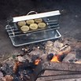
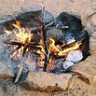
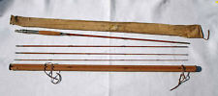
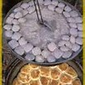
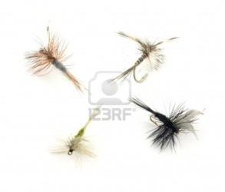
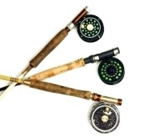
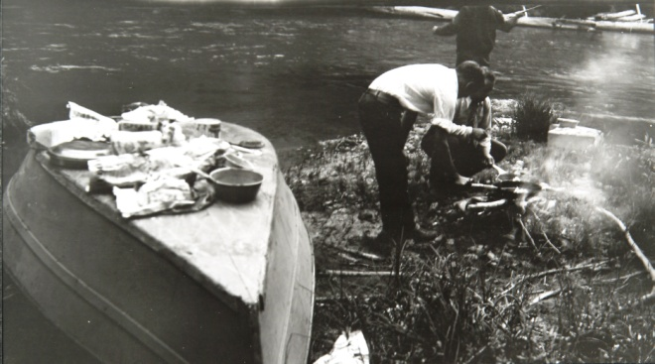
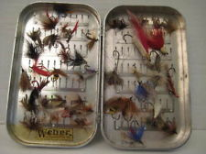
Guide and DB Artifacts

Slide 34
Guides’ Heritage Wall
From the charter members to the present – images and stories

Slide 35
McKenzie Families’ Heritage Wall – The people and culture -
Native American
Earliest pioneers
Hot springs developers
Logging
Farming
Lodges
Contemporary
Other

Slide 36
Summary of goals - World class center -Interactive and user friendly -Gateway to opportunities on the McKenzie - High rate of returnees

Slide 37
Next Steps
Complete draft proposal
Submit to Feasibility Study Group to address question: If you build it, will they come?
Adjust as recommended by the Feasibility group
Raise funds, identify and contract with design teams, contactors and build the thing.

Slide 38
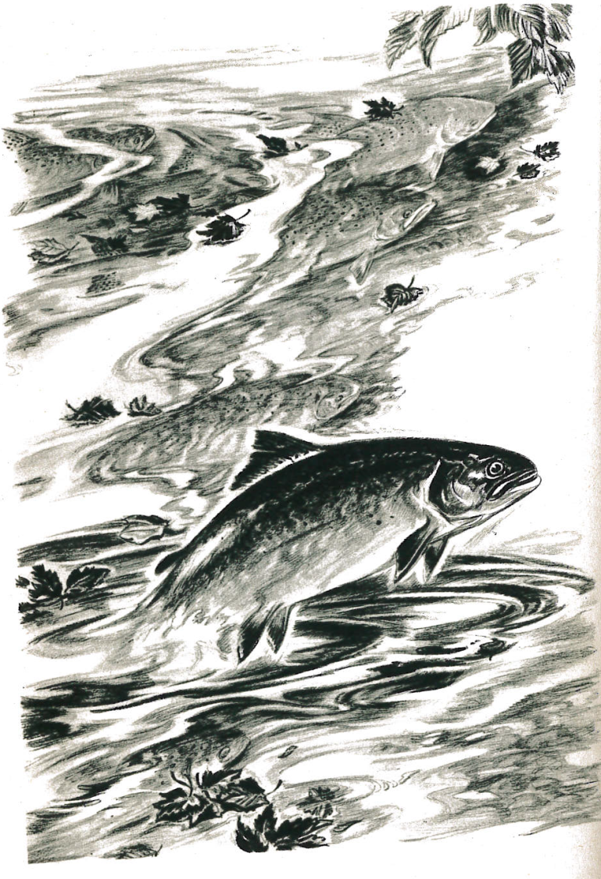
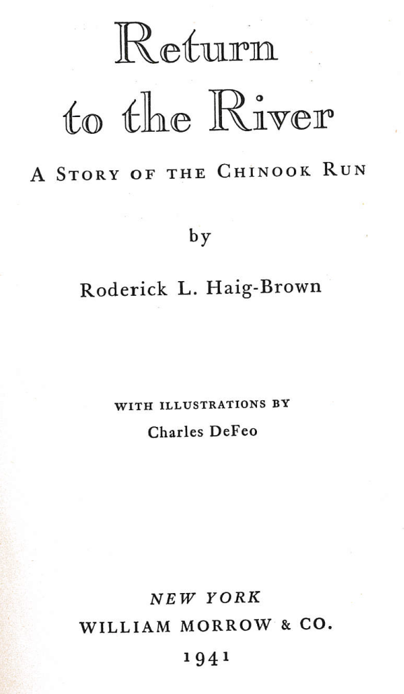
The Return to the Beginning

